Slide 1
Setting up a connection to an HLA Fusion SQL server on a windows computer
Nicholas Brown, PhD, F(ACHI)
University of Pennsylvania
2-16-2022

Slide 2
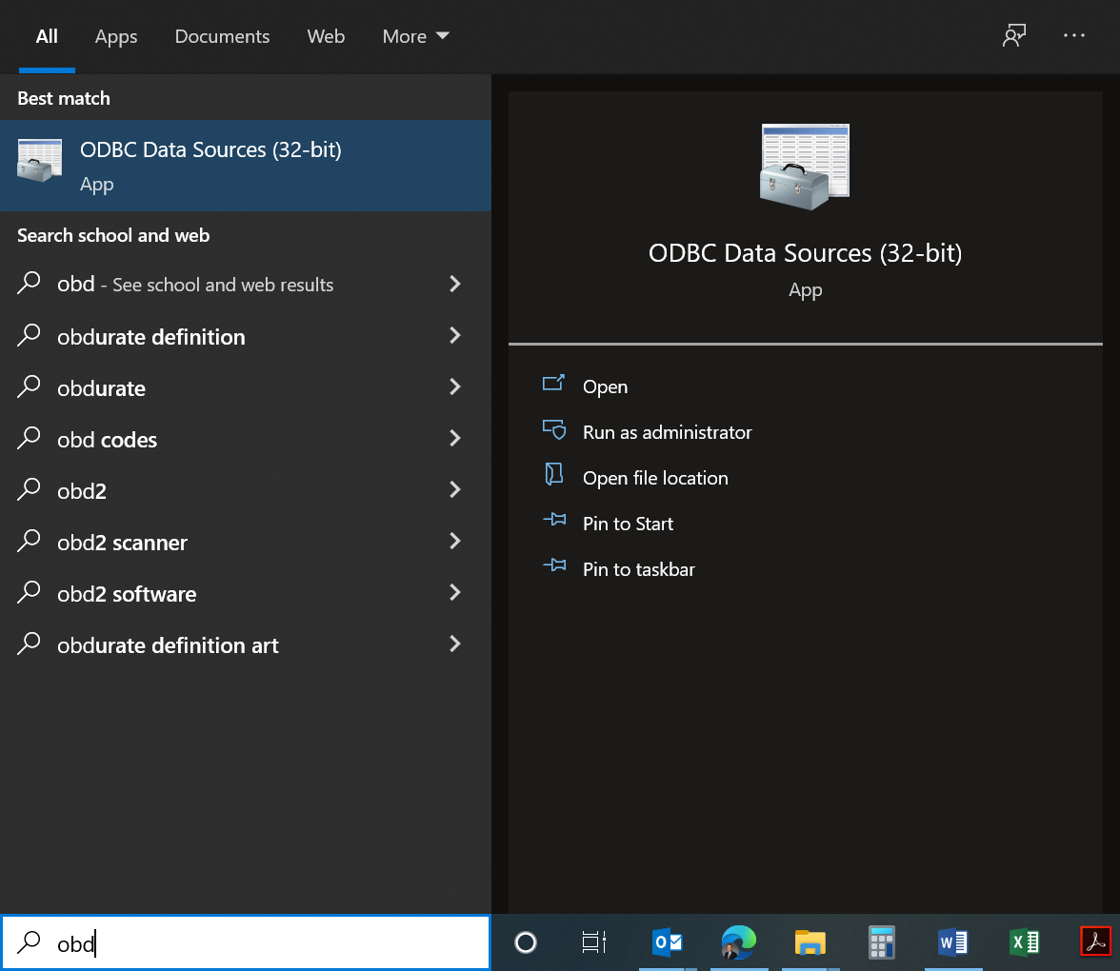
Type “ODBC” into Windows search bar to find and open the “ODBC Data Sources (32-bit)” application

Slide 3
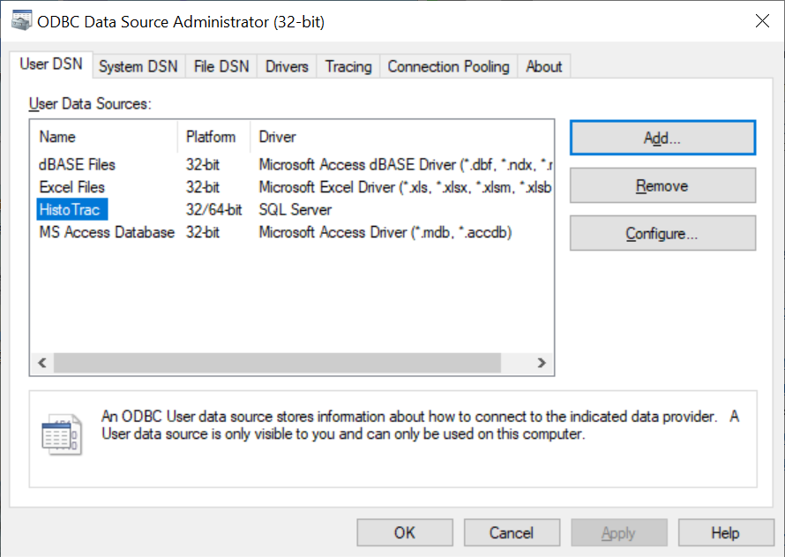
Click on “Add”

Slide 4
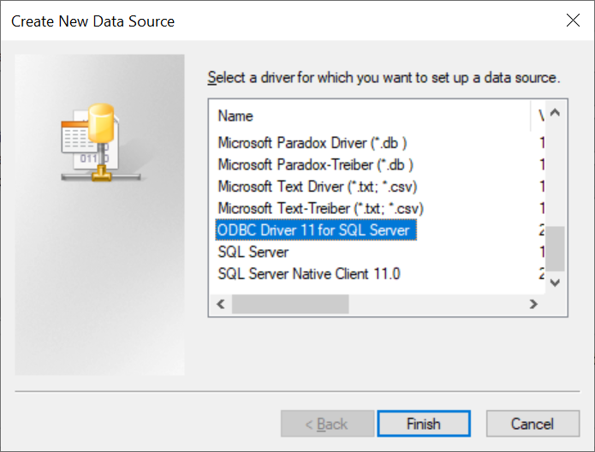
Choose “ODBC Driver 11 for SQL Server”
Note: this step is essentially choosing a driver for your connection. While other drivers may work for your Fusion server, and you might be told by your IT department to choose a different driver, I strongly suggest choosing “ODBC Driver 11 for SQL Server,” as the R code is written to deal with the peculiarities of this driver. If you choose a different driver, you may have to re-write some of the R code.

Slide 5
Give it a name of “Fusion.” I strongly suggest giving it the name “Fusion.” If you give it a different name, you will have to change several lines of code in R to get it to work. If you give it the name of “Fusion” now, you will save yourself lots of hassle.
You will have to supply the name of your server.

Slide 6
This may be different for your setup, but you most likely will have to enter the username and password for the server

Slide 7
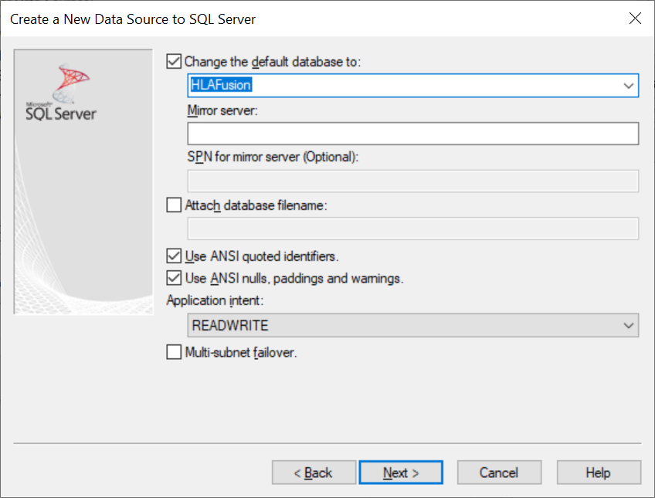
If it doesn’t come up like in the picture here, you may want to check the “change the default database to:” checkbox and select HLAFusion, or whatever you production server is.

Slide 8
Defaults should be fine

Slide 9
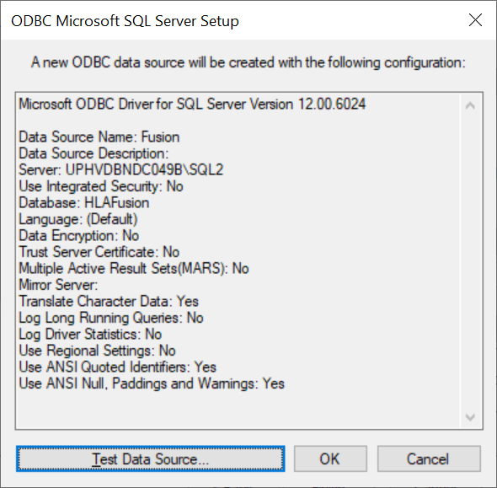
The last step. Double-check everything.

Slide 10
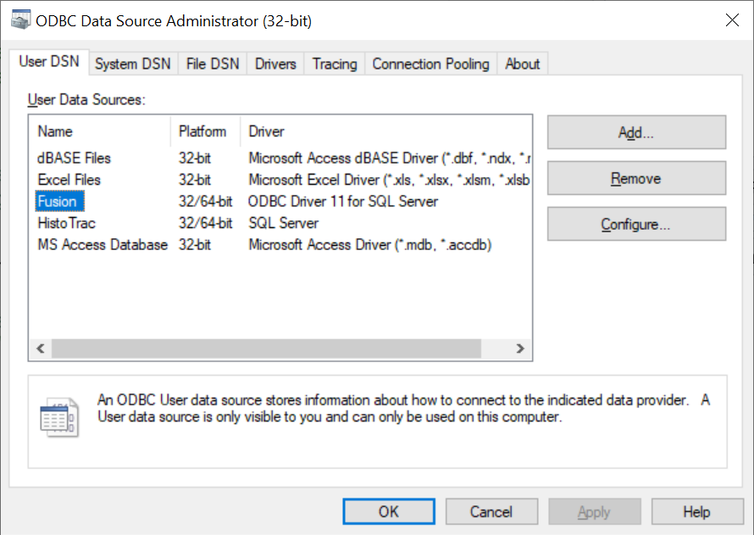
You should now have a connection to your Fusion server from this computer. Open Rstudio on the same computer and you should be able to extract data.

